Slide 1


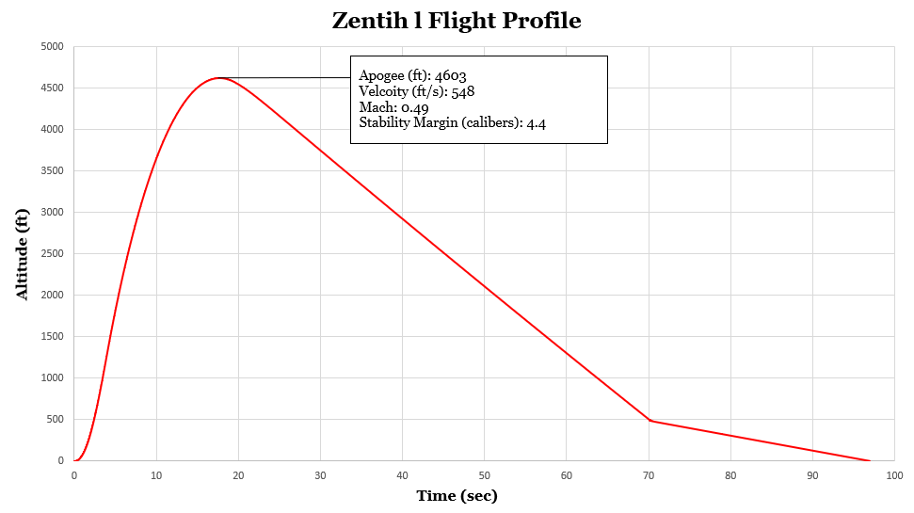
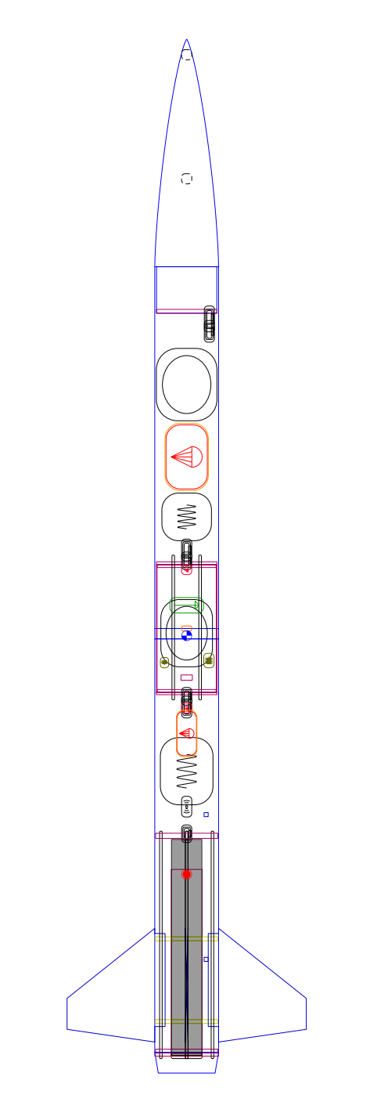
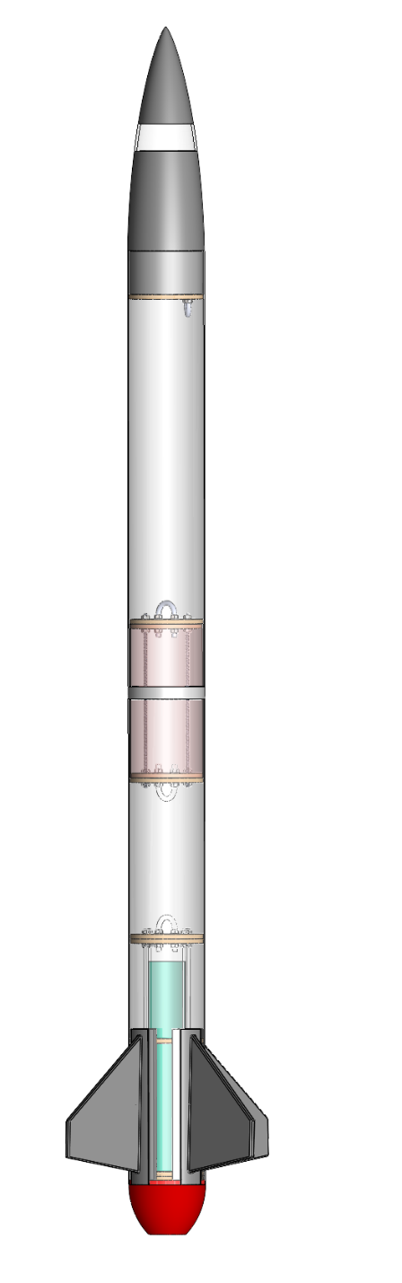

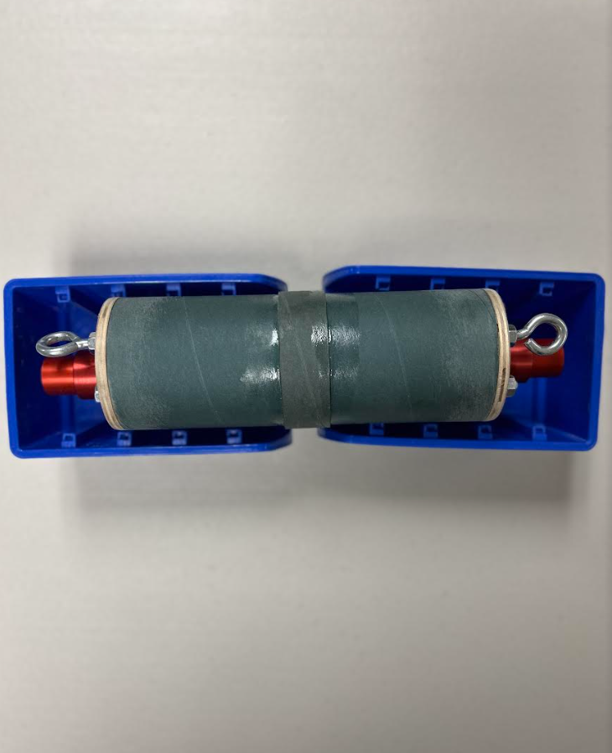
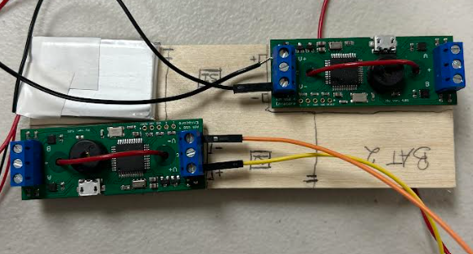
NASA Student Launch
Jedreck Acquissa, Peyton Breland, Dylan Gardner, Mark Ioffredo, Zachary Isriel
FAMU
E
FSU
FSU
-
C
E
Objective
Modeling & Simulations
FAMU
-
Camera House
C
Nosecone
The objective of this project is to fly a high-power solid rocket to an altitude of 4,600 ft that will deploy a payload capable of receiving RF commands and performing tasks, after the flight vehicle has safely recovered.
Payload
Payload
Bay
Main
Parachute
FSU
Bulkheads
E
Drogue
Parachute
OpenRocket Simulation, SolidWorks, and Creo were all used to test the vehicle’s flight performance and conduct FEA/CFD simulations.
-
FAMU
C
Aerotech L850W
E
Motor
Case
-
C
FSU
Thrust Structure
Motivation
FAMU
Future Work
NASA Student Launch aims to build foundational knowledge and inspire the newest generation of space explorers, the Artemis Generation.
Fin Configuration
Fin Configuration
Tail-cone
Assemble and test the subscale flight vehicle to obtain an accurate real-time flight profile.
Facilitate STEM Engagement events with HS/MS STEM clubs in the Leon County community
AV Bay (Sub-scale)
FSU
E
-
E
FAMU
C
FAMU
-
C
FSU

